Slide 1
Blockchain Transaction
GBC Crypto

Slide 2

The issues
1- The normal banking international transactions take at least 5 business days to validate a single transaction
2- Banking transactions usually have a high fees
3-Not descentralized
Banking fees

Slide 3

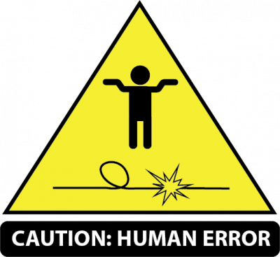

The issues cont…
4-Lack of security
5-Human error
6-limited amount of founds send in one transaction

Slide 4
Solutions
We going to use blockchain to reduce time and process transactions faster
Blockchain is really cheap, so our fees will be less than normal banking
Our transactions will be cross-verified by others computers(miners)
Blockchain is super secure
We don’t need papers or employees to make transactions
In blockchain there is no limit amout for transactions
Facilitate smart contract with our platform
Create a mobile and desktop application
Support for multiple crypto currencies
Keep track of users transactions from the ledger

Slide 5
Phase 1
Project proposal
Project requirements
Design moqups
Technical requirements

Slide 6
Phase 2
Design Prototype
Code implementation

Slide 7
Phase 3
Testing
Debugging
Refactoring
Markting

Slide 8
Evaluation

Slide 9
About us
GBC Crypto uses blockchain to validate transactions between customers and sellers.
GBC Crypto uses smart contract to validate transactions
Smart contract decentralizes transactions validation with a set of rules based on transactions information.

Slide 10
Project Objectives
To provide a secure, robust, scalable, dynamic platform for our users
To create a clean and friendly UI/UX for our users.
To ensure a graphically pleasing and understandable data representation for the potential users of our application.
To secure the user account using a two-way verification process.

Slide 11
About the application
GBC Crypto validates users online transactions.
When the customer makes a purchase online, GBC crypto will generate a smart contract and only when the customer confirms that they receives the product the online store will receive the payment.
GBC Crypto provides a graphically interface.

Slide 12
About the application
GBC Crypto tend to offer lower fees than traditional credit card payment systems. Some of these tools can be highly customizable and provide native dashboards to help track all payments. Bitcoin is the most commonly supported cryptocurrency used during transactions with these systems, but some gateways provide the ability to pay with alternative currencies.
GBC Crypto can integrate with e-commerce platforms, point-of-sale systems, shopping cart software, billing and accounting solutions, and more.

Slide 13
Ledger
Money going in and money going out.
Online banking account history.
There changes every day and every transaction.

Slide 14
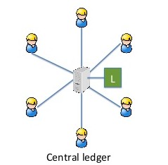
Centralized Ledger
Central authority is the one we must trust to keep the ledger up to date.

Slide 15
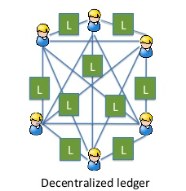
Decentralized Ledger
In decentralized network, theres thousands of computers around the world trying to update the ledger.

Slide 16
Decentralized Ledger. Who updates it??
Every 10 mins, the block chain gets updated.
Computer battles to solve energy intensive task.
Computer with most processing power wins
Others in the network verify the problem.

Slide 17
Decentralized Ledger Contd…
The Task – Big boi computing….
Every miner cross checks all transactions that took place since day 1.
More than 50% agreement, then that block of transaction is updated on the ledger.
So block chain is basically a distributed ledger..

Slide 18
Banks and Blockchain, Correspondent banking
Wheres my money???
Linked banks – ledgers exchanged at the end of the day.
Ledgers verified manually.
VERY SLOW.

Slide 19
PROBLEM SOLVED!
Alice’s bank is decentrally connected to Bob’s bank through the blockchain..
No need for other people.
You know where your money is instantaneously.

Slide 20
Smart Contracts
What is a smart contract?
A Smart contract , also known as self-executing contract, allow you to exchange money or goods (anything of value), in a transparent way by avoiding the middleman.
Ex. It is similar to a vending machine - You submit your information and cryptocurrency into the vending machine (smart contract), and you agreement drops into your account.

Slide 21
Benefits
Autonomy - Because you are the one making the agreement, there is no need for brokers, lawyers to make a confirmation.
Savings - You save money by removing the middleman. For example, if you sell your home you won't have to pay a real estate agents for all the of necessary documents and legal permissions.
Trust - Your transactions are encrypted on a shared ledger, so there is no room for human errors to interrupt the transaction in any way.
Backup - Your documents are duplicated many times over and are retrievable from any other node on the network.
Speed/Accuracy - Blockchain uses code to automate tasks, instead of manually processing documents. It is also more accurate because is avoids the errors that happen when manually entering information.

Slide 22
Goals
Facilitate smart contract with our platform
Create a mobile and desktop application
Support for multiple crypto currencies
Keep track of users transactions from the ledger

Slide 23
References
https://medium.com/ignation/pulling-the-blockchain-apart-the-transaction-life-cycle-7a1465d75fa3
https://blockchainhub.net/blockchains-and-distributed-ledger-technologies-in-general/

